Slide 1
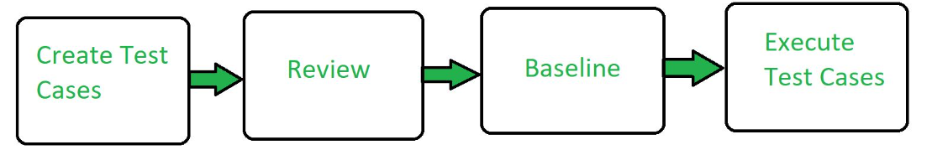
Functional Testing
Unit testing: It is a software testing technique where individual units or components of a software application are tested independently. The purpose is to validate that each unit of the software performs as expected. Unit testing is typically automated and focuses on isolating the smallest testable parts of the code, such as functions, methods, or classes.
Unit Testing Example: Mock Objects
Unit testing relies on mock objects being created to test sections of code that are not yet part of a complete application. Mock objects fill in for the missing parts of the program.
For example, you might have a function that needs variables or objects that are not created yet. In unit testing, those will be accounted for in the form of mock objects created solely for the purpose of the unit testing done on that section of code.

Slide 2
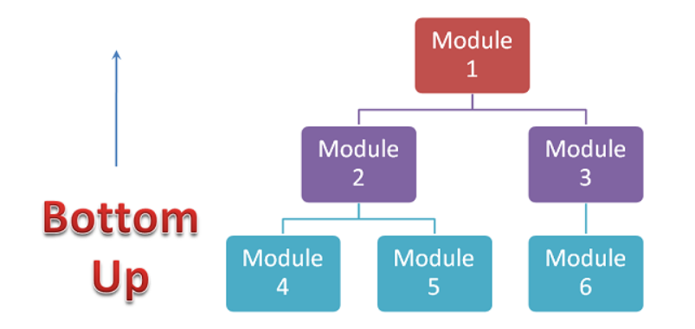
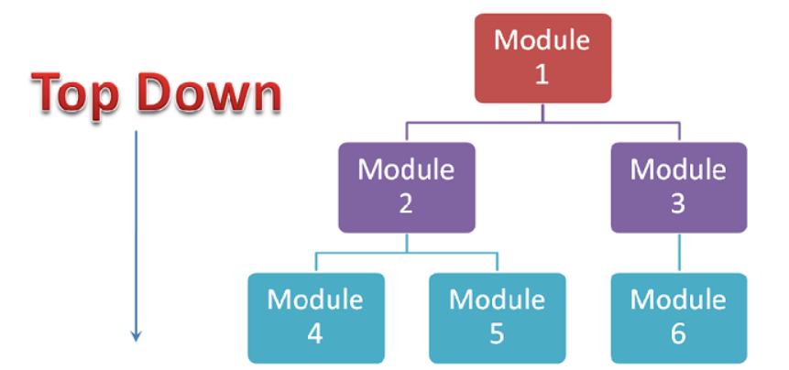
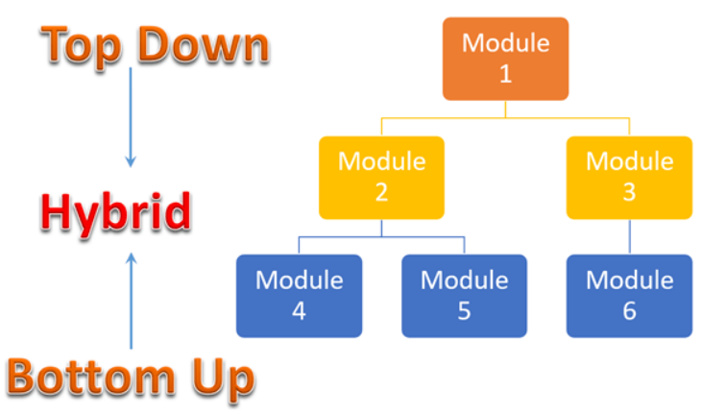
Integration testing: It is a phase in software testing where individual units or components of a software application are combined and tested as a group. The purpose is to verify that the interactions between these components work as expected and that the integrated system functions correctly as a whole.

Slide 3
Integration Testing Types:
a. Top-Down Integration Testing:
Start testing from the top-level modules and gradually move down to lower-level modules.
Stubs are used to simulate lower-level modules that are not yet developed.
b. Bottom-Up Integration Testing:
Start testing from the lower-level modules and gradually move up to top-level modules.
Drivers are used to simulate higher-level modules that are not yet developed.
c. Big Bang Integration Testing:
All modules are integrated simultaneously, and the entire system is tested as a whole.
Suitable for small projects or when individual modules are relatively independent.
d. Incremental Integration Testing:
System is built and tested incrementally, with new modules integrated and tested in isolation first before being integrated with the existing system.
Can be performed in a top-down or bottom-up manner.

